Slide 1

Analytical Reasoning AND Non-Verbal Reasoning

Slide 2
Analytical Reasoning
Mirror images concept & Practice from PPT
Non-Verbal Reasoning
Paper cutting and folding & Practice from PPT
Water images concept & Practice from PPT
Counting of figures concept & Practice from PPT
Matrix completion & Practice from PPT
Drawing the relation between words & Practice from PPT
finding images to complete the series & Practice from PPT
Completion of figures & Practice from PPT
Embedded Images & Practice from PPT
Image grouping & Practice from PPT

Slide 3
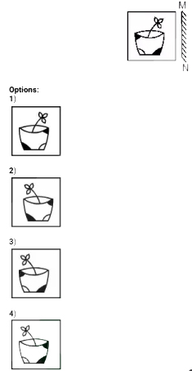
Mirror Image
1. If a mirror is placed on the line MN, then which of the answer figures is the right image of the given figure?
A] 1 | B] 2
C] 3 | D] 4
Notes:
Answer: B) 2
Difficulty level: Easy (Compulsory)

Slide 4

Mirror Image
2. Choose the correct figure of a mirror image
A] A | B] C
C] B | D] D
Notes:
Correct Option: C
Difficulty level: Easy (Optional)

Slide 5
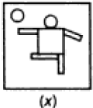
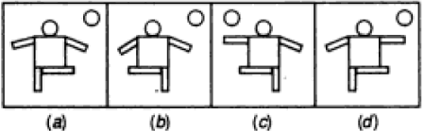
Mirror Image
3. Choose the correct figure of a mirror image:
A] A B] B
C] C D] D
Notes:
Option: D
Difficulty level: Moderate

Slide 6

Mirror Image
4. Choose the alternative which closely resembles the mirror image:
1 | B) 2
C) 3 | D) 4
Notes:
Answer: D
Difficulty level: Moderate (Compulsory)

Slide 7

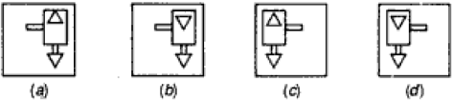
Water Image
5. Choose the alternative which is closely resembles the water image of the given combination.
A] A B] B
C] C D] D
Notes:
Option A
Difficulty level: Easy (Compulsory)

Slide 8
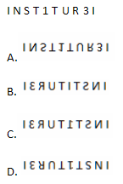
Water Image
6. Choose the alternative which is closely resembles the water image of the given combination.
Notes:
Option A
Difficulty level: Easy (Compulsory)

Slide 9
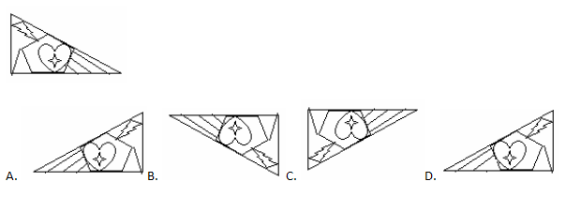
Water Image
7. Choose the alternative which is closely resembles the water image of the given combination:
Notes:
Option C
Difficulty level: Moderate

Slide 10
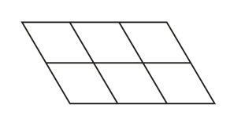
Counting Figures
8. Find the number of parallelograms in the below figure
A] 18 | B] 20
C] 19 | D] 16
Notes:
Answer: A) 18
6+7+2+2+1 = 18.
Difficulty level: Easy (Optional)

Slide 11

Counting Figures
9.Find the number of triangles in the given figure:
A] 28 | B] 32
C] 36 | D] 4
Notes:
Correct option: C
= 12 + 4 + 8 + 8 + 4 = 36
Difficulty level: Moderate (Compulsory)

Slide 12
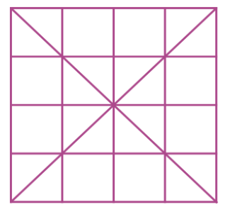
Counting Figures
10. Find the number of squares in the given figure?
A] 58 | B] 37
C] 44 | D] 30
Notes:
Option D
Difficulty level: Moderate

Slide 13
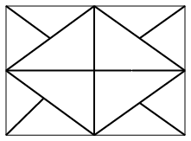
Counting Figures
11. How many triangles are there in the following figure?
A] 12 | B] 16
C] 20 | D] 10
Notes:
Option C
Difficulty level: Moderate (Compulsory)

Slide 14
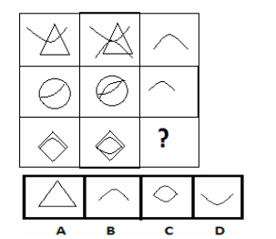
Matrix Completion
12. Select a suitable figure from the four alternatives that would complete the figure matrix:
Notes:
Correct Option: D
Difficulty level: Easy (Compulsory)

Slide 15
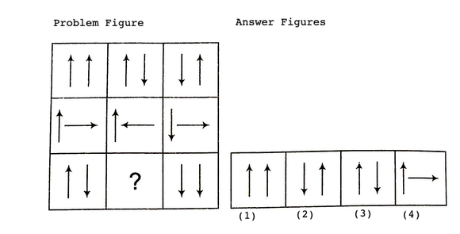
Matrix Completion
13. Find out the answer figure which completes the problem figure matrix:
Notes:
Ans: Option 1
Second figure in each row consists of first arrow of the first figure as such and the second one in an inverted form. The third figure is obtained by inverting the arrows of second figure.
Difficulty level: Moderate (Compulsory)

Slide 16

Analytical Reasoning
14. Identify the diagram that best represents the relationship among classes given below:
Males, Fathers, Engineers
A] 1 | B] 2
C] 3 | D] 4
Notes:
Answer: C) 3
Difficulty level: Moderate (Compulsory)

Slide 17
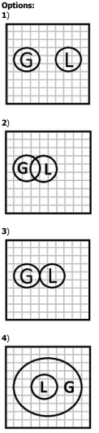
Analytical Reasoning
15. In a village some of the goldsmiths are literates. Which diagram shows literate goldsmiths?
A) 1 | B) 2
C) 3 | D) 4
Notes:
Answer: B) 2
Difficulty level: Moderate (Optional)

Slide 18
Non-Verbal Reasoning
Direction (16 to 18): Each of the following questions consists of a set of three figures X, Y and Z showing a sequence of folding of a piece of paper. Fig (Z) shows the manner in which the folded paper has been cut. These three figures are followed by four answer figures from which you have to choose a figure which would most closely resemble the unfolded form fig. (Z)

Slide 19
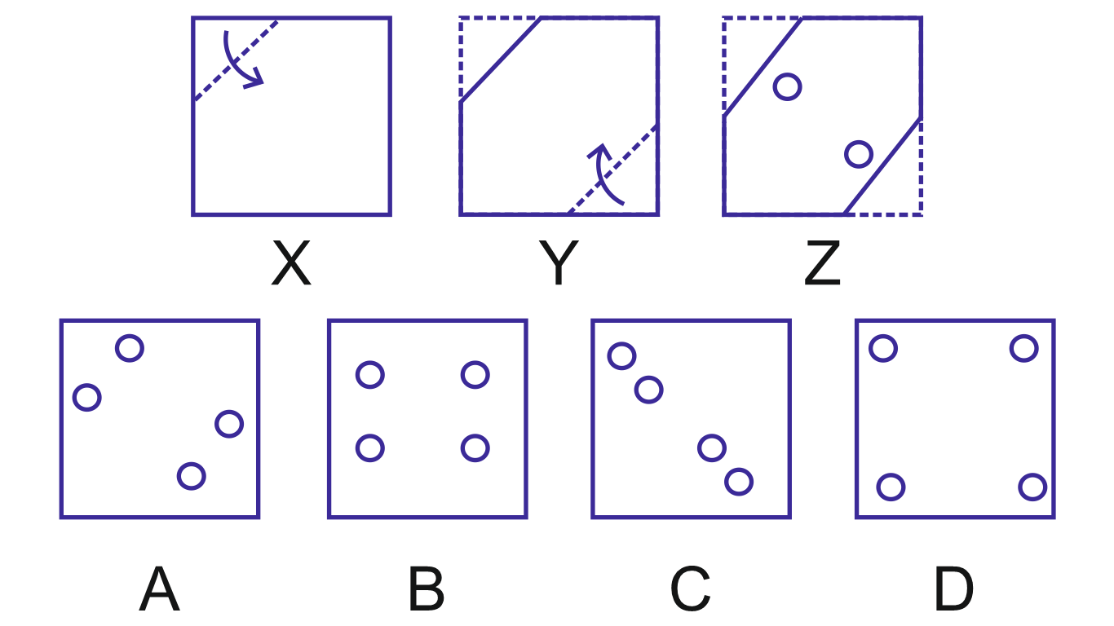
Non-Verbal Reasoning
Q.16.
Notes:
Option C
Difficulty level: Easy (Compulsory)

Slide 20
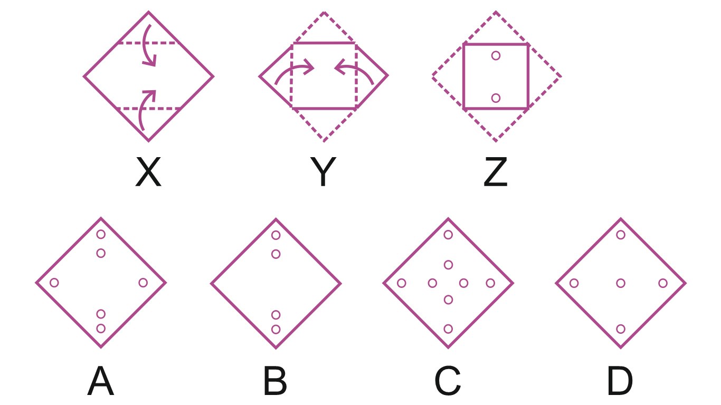
Non-Verbal Reasoning
Q.17.
Notes:
Option B
Difficulty level: Moderate

Slide 21
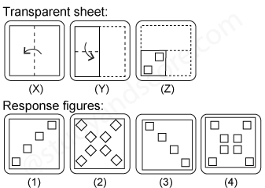
Non-Verbal Reasoning
Q.18.
Notes:
Option 4
Difficulty level: Moderate (Compulsory)

Slide 22
Non-Verbal Reasoning
Directions 19- 20: In the following questions two sets of pictures are given. In the first picture set, a series pattern A, B, C, D and E is given, you have to find out which picture from 1, 2, 3, 4 and 5 will continue the pattern given in the first set of the picture.

Slide 23

Non-Verbal Reasoning
Q19. Select a figure which will continue the series given in the first picture :-
Notes:
Option 1
Difficulty level: Moderate (Compulsory)

Slide 24

Non-Verbal Reasoning
Q20. Select a figure which will continue the series given in the first picture :-
Notes:
Option 1
Difficulty level: Moderate (Compulsory)

Slide 25
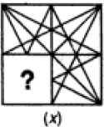




Non-Verbal Reasoning
Q21. Select a figure from the four alternatives, which when placed in the blank space of fig. (x).
A
B
C
D
Notes:
Option D
Difficulty level: Moderate (Compulsory)

Slide 26

Non-Verbal Reasoning
Q22. Select a figure from the four alternatives, which when placed in the blank space of fig. (x).
X
A
B
C
D
Notes:
Option D
Difficulty level: Moderate (Compulsory)

Slide 27
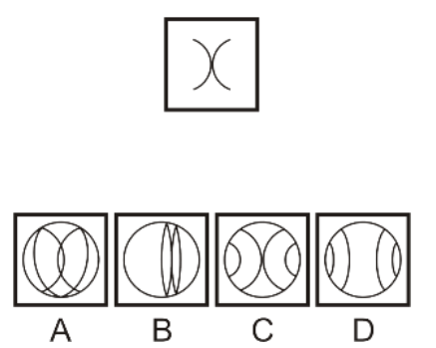
Non-Verbal Reasoning
Q 23 Choose the alternative which is closely resembles the Embedded figure of the given figure
Notes:
Option C
Difficulty level: Easy (Optional)

Slide 28
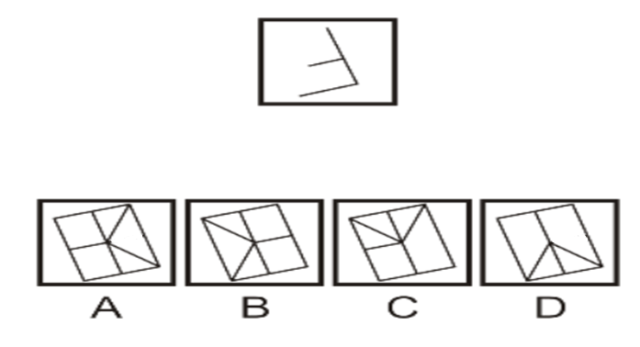
Non-Verbal Reasoning
Q 24 Choose the alternative which is closely resembles the Embedded figure of the given figure
Notes:
Option B
Difficulty level: Moderate (Compulsory)

Slide 29
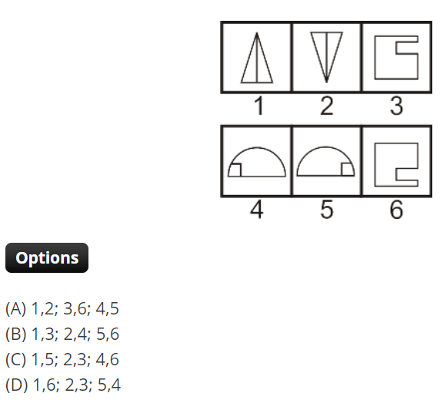
Non-Verbal Reasoning
Direction(Q25-26): In each of the following questions, group the given figures into three classes using each figure only once
25. Choose the correct sequence which are the group of identical images
Notes:
Option A
Difficulty level: Moderate (Compulsory)

Slide 30
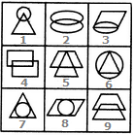

Non-Verbal Reasoning
Q 26 Choose the correct sequence which are the group of identical images
1,5,9 ; 2,7,8 ; 3,4,6
2,4,9 ; 6,7,8 ; 1,3,5
3,7,8 ; 4,5,9 ; 1,2,6
1,5,6 ; 4,7,8 ; 2,3,9
Notes:
Option B
Difficulty level: Moderate (Compulsory)

Slide 31
Any Doubts???

